Slide 1
Welcome to the PQIP Collaborative DrEaMing Webinar
7th March 2023 1-2pm
@rmoonesinghe @jbedford84 @PQIPnews @NHSGIRFT @RCOAnews @HSRCNews @NHSEngland

Slide 2
Welcome and the DrEaMing CQUIN update for 2023/2024:
Professor Ramani Moonesinghe, PQIP Chief Investigator and National Clinical Director for Critical and Perioperative Care, NHS England
PQIP pomVLAD - rapid feedback of risk-adjusted morbidity outcomes through a near-real time web-based dashboard:
Dr James Bedford, Former PQIP Fellow, Consultant Anaesthetist University College London Hospital
Audience Q&A
Agenda

Slide 3
DrEaMing Highlights
•“A DrEaMing bundle re-prioritises early postoperative delivery of Drinking, Eating and Mobilising”
•Delivery of DrEaMing as a bundle or unbundled is associated with substantial reductions in postoperative LOS
•Consistency of process delivery, not complications, predicted shorter hospital-level LOS
•The DrEaMing CQUIN has been updated for 2023/2024 to include a wider range of surgical procedures and with a higher target threshold of 80%, to help ensure more patients DrEaM after surgery.

Slide 4
Launching pomVLAD!
The pomVLAD project aims to support local quality improvement with rapid feedback of risk-adjusted morbidity outcomes through a near-real time web-based dashboard showing observed against expected post-operative complications for PQIP colorectal patients
Accurate, risk-adjusted, near-real time data that describes the pattern and prevalence of complications and deaths will enable your teams to examine your local processes and improve outcomes
Included in the dashboard are easy-to-interpret dials representing 10 PQIP-recommended enhanced-recovery processes

Slide 5
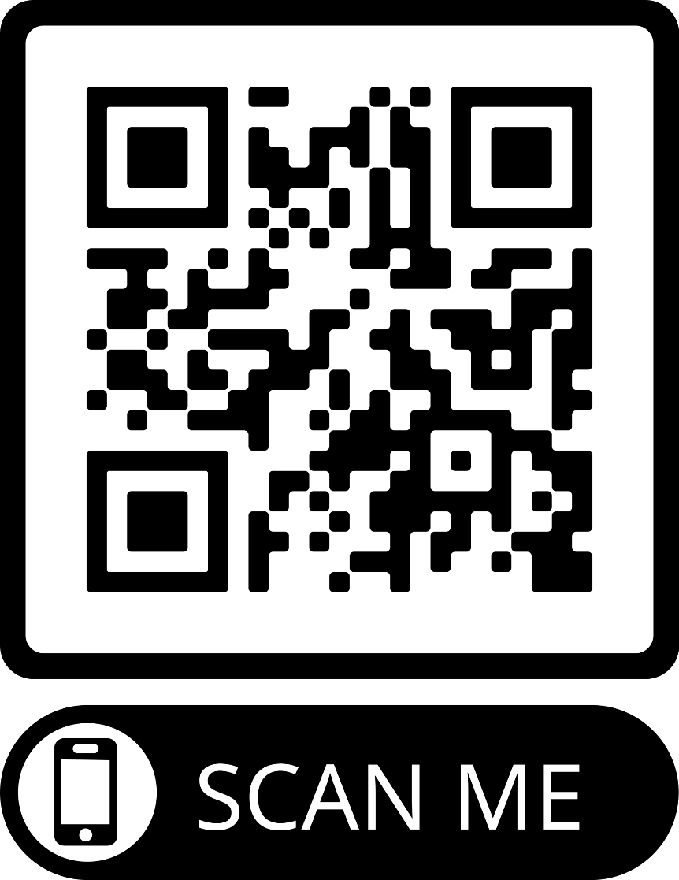
Your feedback helps shape the future webinars - the PQIP team want to hear about your DrEaMing successes and challenges
Quality improvement is notoriously difficult and PQIP want to support you and your local teams to QI success.
One way to support the collaborative is to share your local teams' experiences with implementing DrEaMing including challenges faced, as well as success stories.
Through information sharing we can all learn together techniques that could enhance our current QI efforts and help more patients to DrEaM than ever before.
If you and your local team have a QI story you want to share, please leave your contact details in the feedback form or contact PQIP@RCOA.ac.uk

